Slide 1

Department of Computer Science and Engineering
Vessel detection from space borne images
Date: 28 May 2021
Nikitha Kambhampati - 17WH1A0507
Pagilla Sai Preethi - 17WH1A0547
Gaddam Nikitha - 18WH5A0502
Internal Guide : Ms. C Jagadeeswari Designation : Assistant Professor

Slide 2


Abstract
Why Should I Study this course?
Examples
BVRIT HYDERABAD College of Engineering for Women
Problem Statement:
This project aims at detecting large vessels (ships) in sea from satellite images.
Ship detection from remote sensing imagery is a crucial application for maritime security which includes traffic surveillance, protection against illegal fisheries, oil discharge control and sea pollution monitoring.
Project Objective:
To build an algorithm to automatically detect and segment ships in satellite images. Some of the challenging factors include flaws in image quality like uneven brightness, obstruction, many images which have similar shape, color and texture.
Another problem is that objects like islands, ports, whales etc look quite similar to ships. The algorithm had to be extremely accurate because lives and billions of dollars in energy infrastructure is at stake. In this algorithm custom MASK R CNN with ResNet-50 is used for predicting with more accuracy.

Slide 3
Project Modules
There are three modules in the project. They are as follows:
1.Detection of Vessel:
Feeding the training data into ResNet-50 network and classifying if an image has vessel or not.
2.Segmentation of Vessel:
Feeding the training data into Mask RCNN to obtain the masks for testing data. Mask is used to segment the vessel.
3.Graphical User Interface:
Combining the detection model and segmentation model. It facilitates the user to upload a satellite image and the model detects if a vessel is there in it. If vessel is detected it provides the segmentation as to know where the vessel is located in the picture(bounding box).

Slide 4
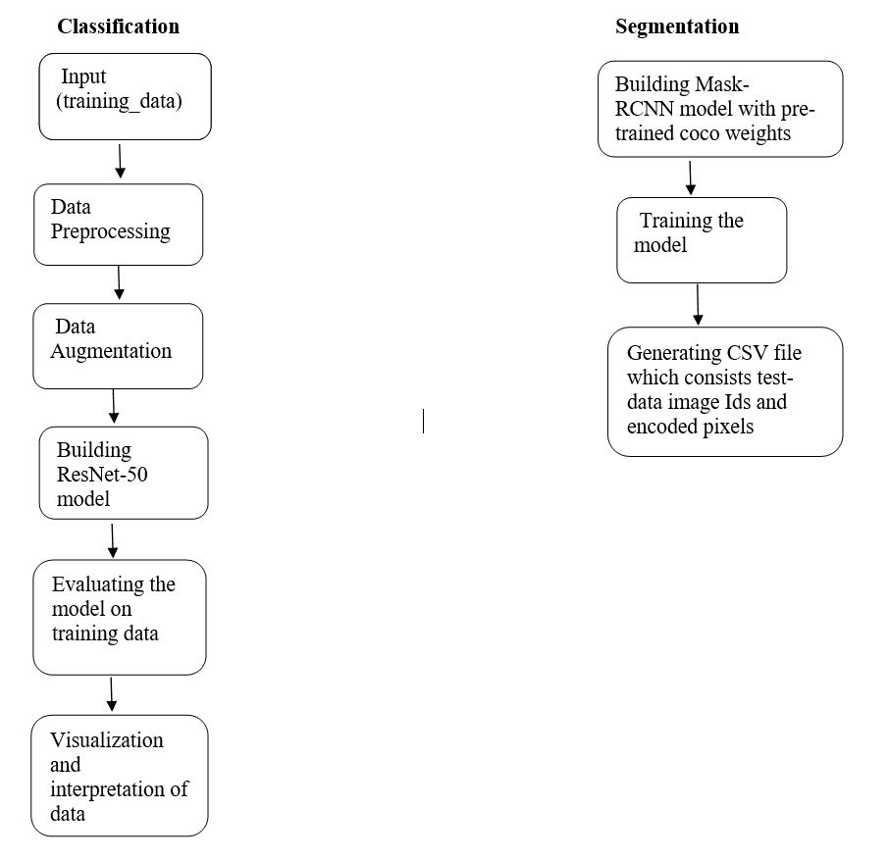
Architecture

Slide 5
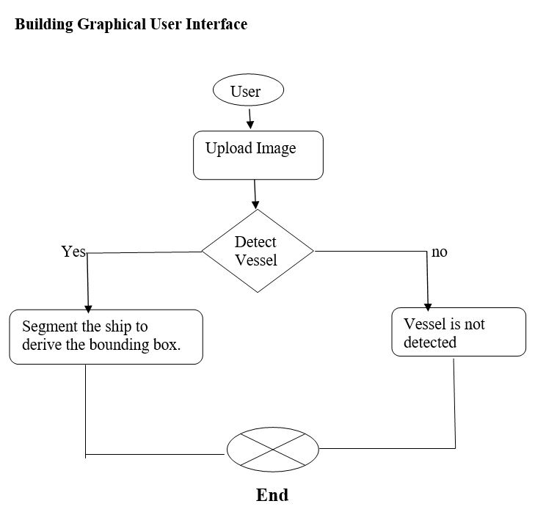

Slide 6
Metrics
Metrics:
Resnet(for Classification) accuracy – 85.3% for 30 epochs
mrcnn_mask_loss(Segmentation) : 0.3868 for 14 epochs
(mrcnn_mask_loss : How well the Mask RCNN segment objects)
mrcnn_bbox_loss: 0.2656 for 14 epochs
(mrcnn_bbox_loss : How well the Mask RCNN localize objects)
Comparison:
Mask RCNN more efficient than YOLO for single instance segmentation problems and is enhanced version of fast RCNN, faster RCNN

Slide 7
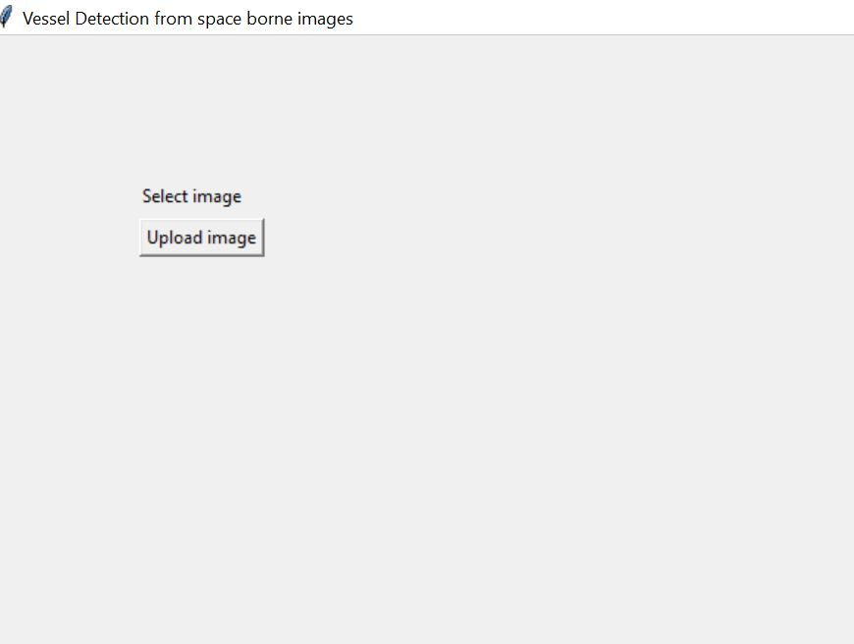
Output

Slide 8
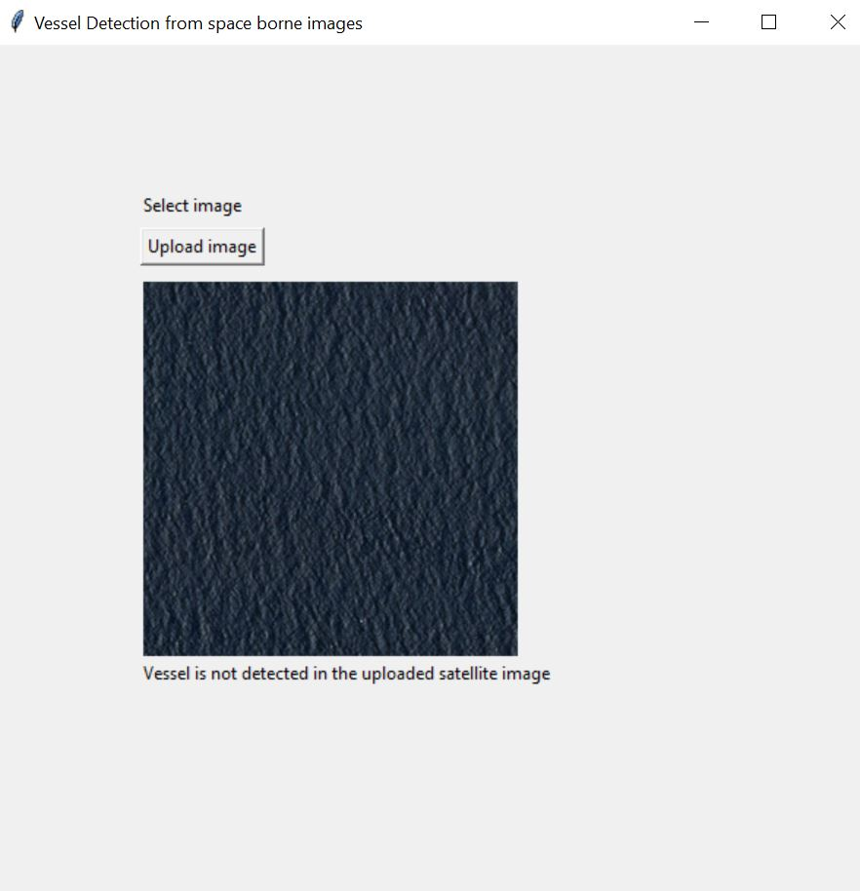

Slide 9
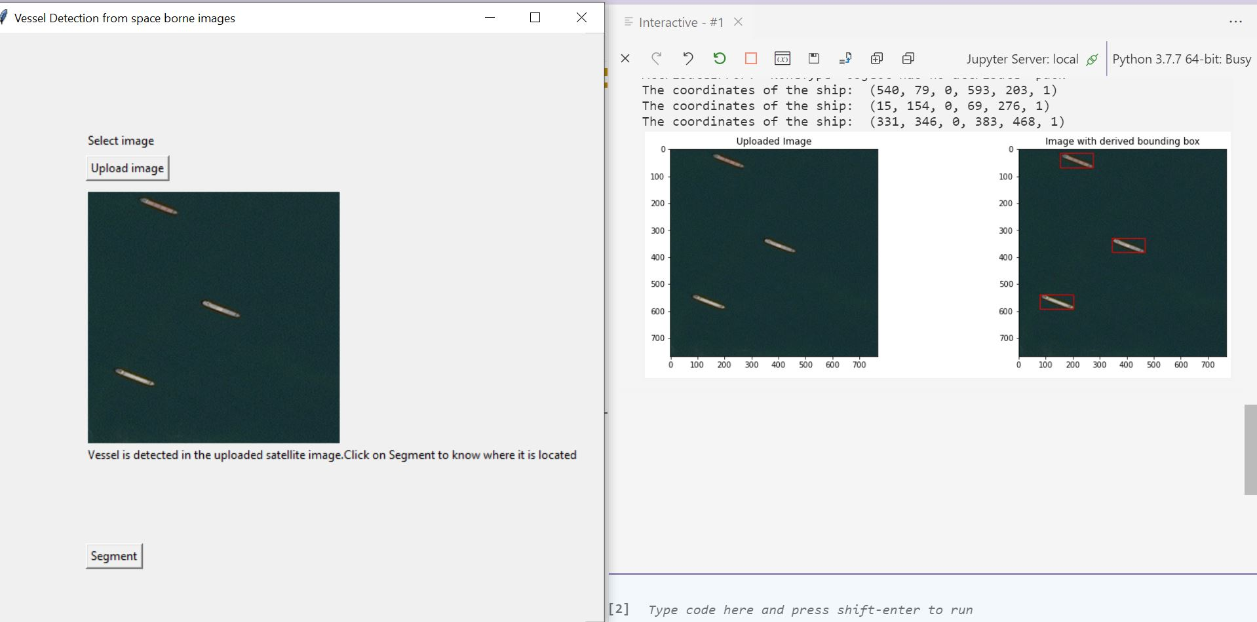

Slide 10
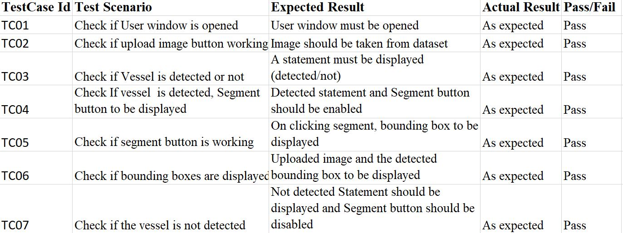
Test cases

Slide 11
References
Base Paper: Real time detection and segmentation of ships
http://www.ijstr.org/final-print/dec2019/Real-Time-Detection-And-Segmentation-Of-Ships-In-Satellite-Images.pdf
An intelligent ship detection using CNN
https://www.hindawi.com/journals/complexity/2020/1520872/
Ship detection using high resolution satellite imagery
https://earth.esa.int/eogateway/documents/20142/37627/8-Ship-Detection-High-Res-Satellite-Imagery.pdf
Ship Detection and Classification on Optical Remote Sensing Images Using Deep Learning
https://www.researchgate.net/publication/319485878_Ship_Detection_and_Classification_on_Optical_Remote_Sensing_Images_Using_Deep_Learning

Slide 12
Thank you

